Slide 1

Agent Activity Chart
3/22/2023 7:06 AM
Print User : selenium.automation
Page 1 of 3

Slide 2
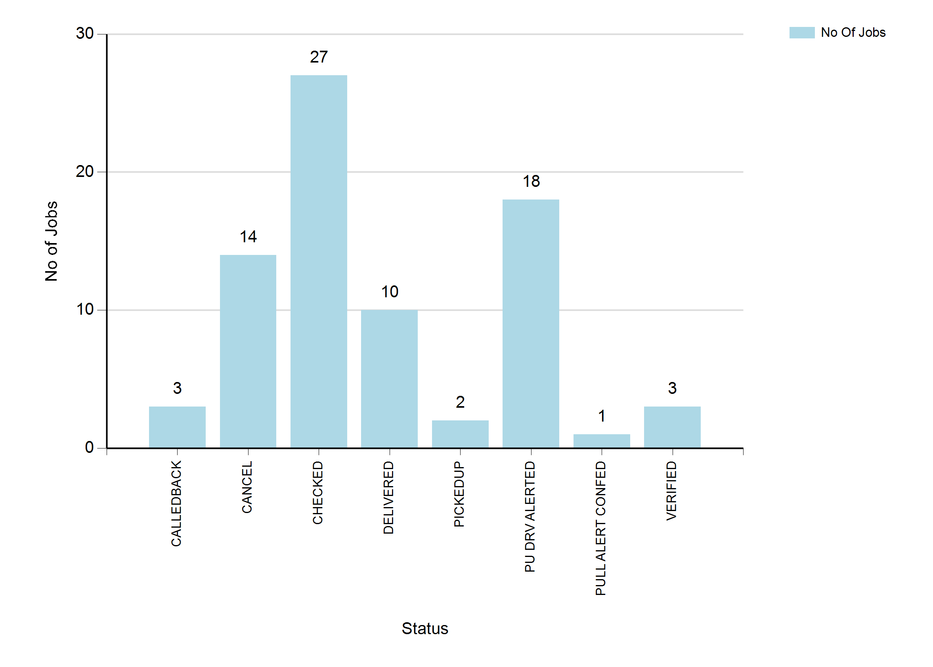
3/22/2023 7:06 AM
Print User : selenium.automation
Page 2 of 3

Slide 3
3/22/2023 7:06 AM
Print User : selenium.automation
Page 3 of 3

